Slide 1
Processor Organization
LECTURE 4

Slide 2
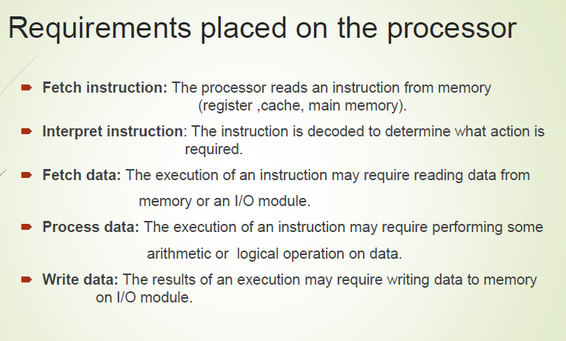

Slide 3
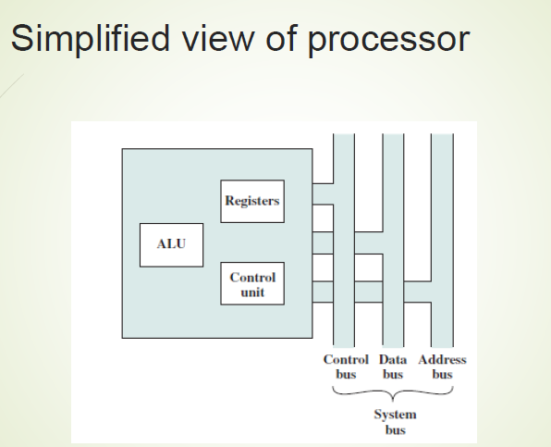

Slide 4
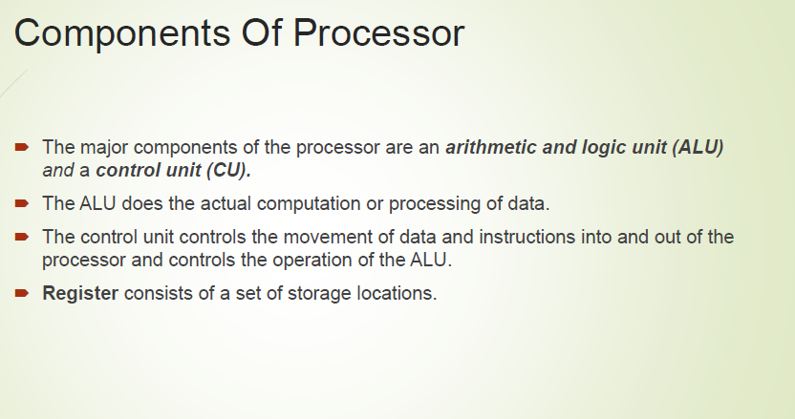

Slide 5
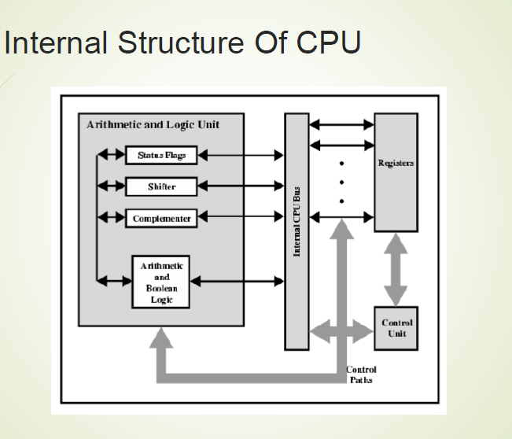

Slide 6
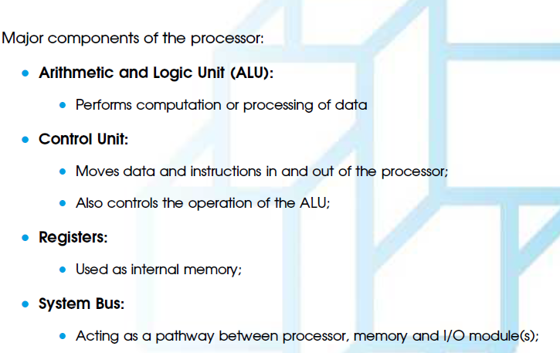

Slide 7
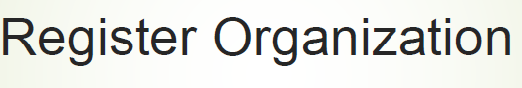

Slide 8
Register Organization
According to Uses of each register they are divided into:
General-Purpose Reg.
Special-Purpose Reg.
Address Reg.

Slide 9
Register Organization
According to operation registers are classified by:
Memory Access Reg.
Instruction Fetching Reg.
Conditional Reg.
Special –Purpose Address Reg.

Slide 10
Memory Access Register
There are Two resisters referred as Memory Access Reg.
Memory Data Reg.(MDR)
Memory Address Reg.(MAR)

Slide 11
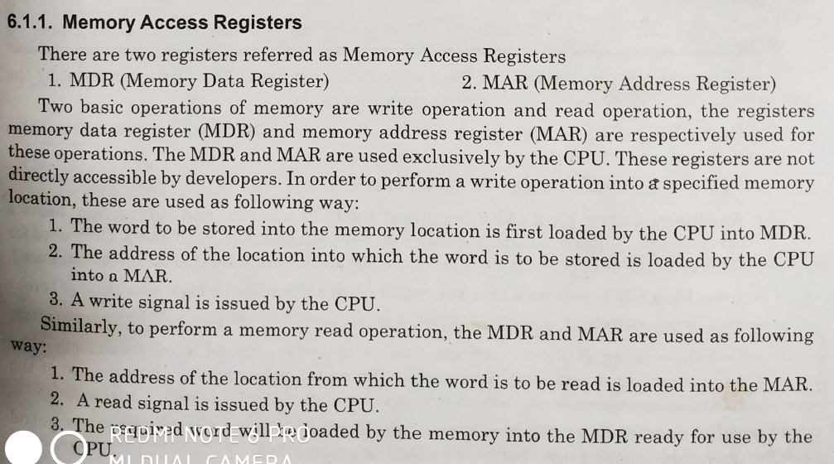
Memory Access Register

Slide 12
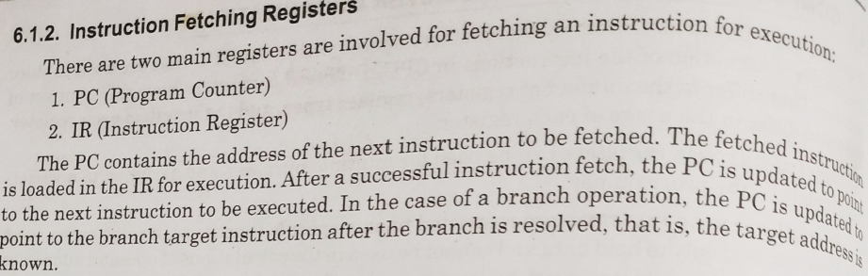
Instruction Fetching Registers

Slide 13
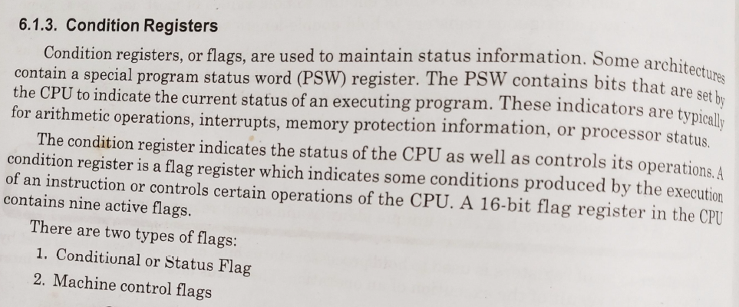
Conditional Register

Slide 14
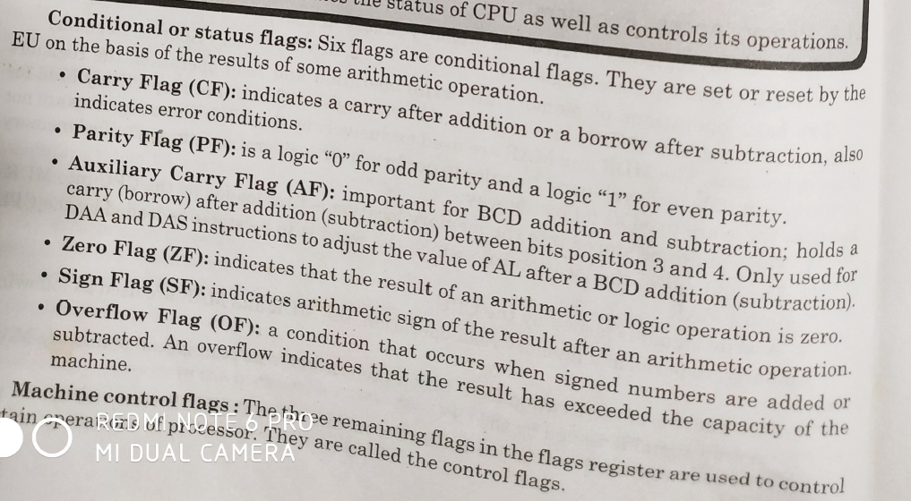

Slide 15
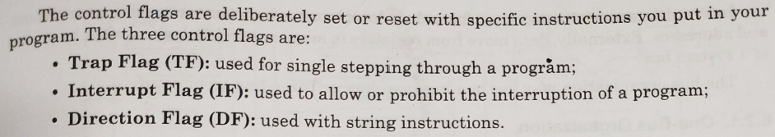
Machine Control Register

Slide 16
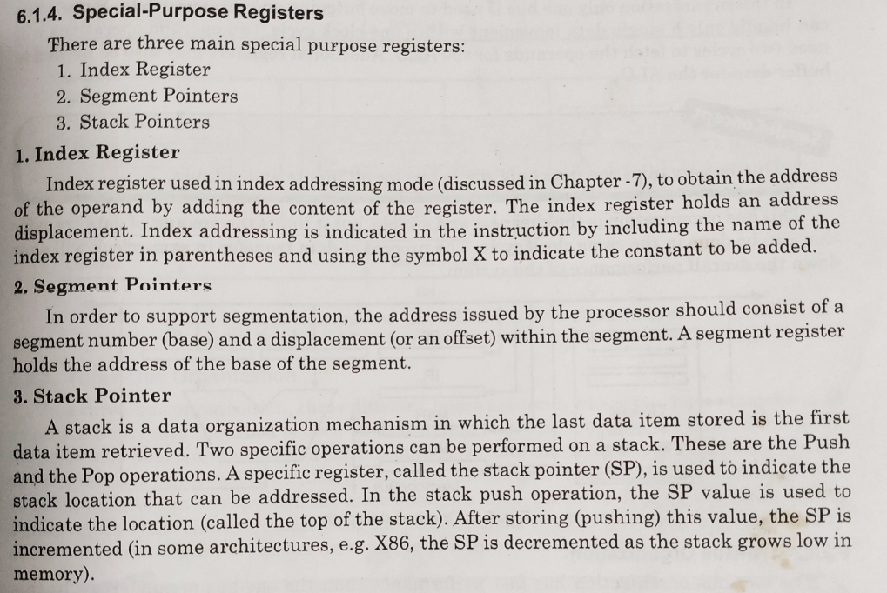

Slide 17
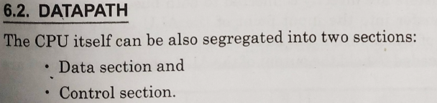
DATA PATH

Slide 18
DATA PATH
There are three BUS organization:
One BUS Organization
Two BUS Organization
Three BUS Organization

Slide 19
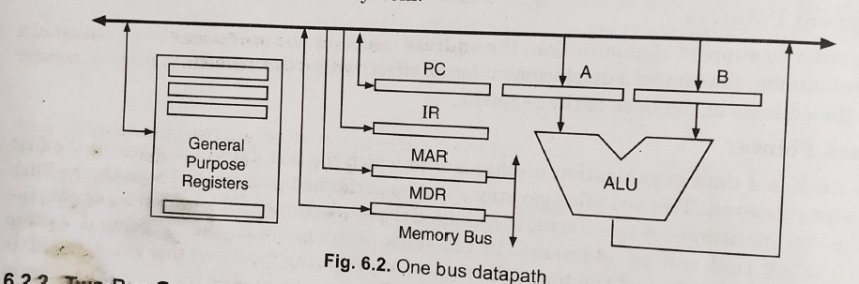
One BUS Organization

Slide 20
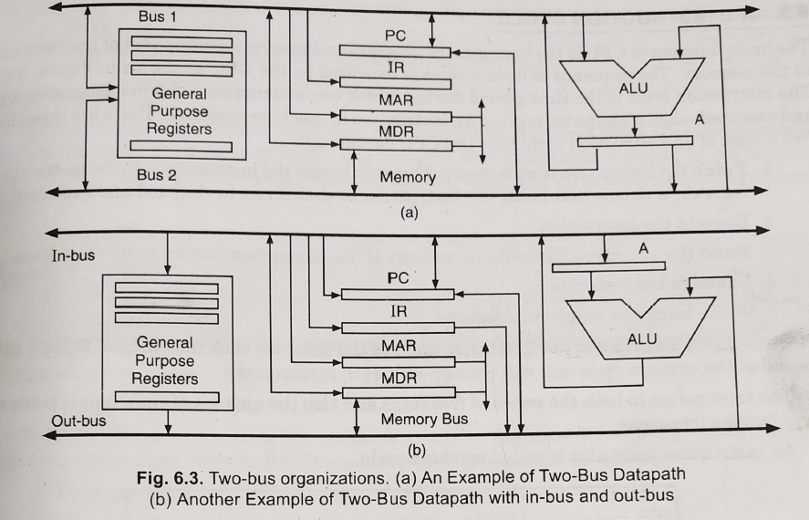
Two BUS Organization

Slide 21
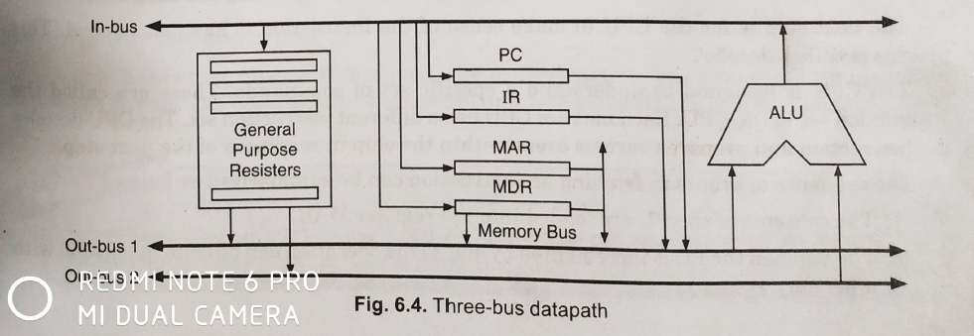
Three BUS Organization

